Slide 1
Calendar Systems:
A Gateway to Language and Literacy
Hilary Hodes
Project Coordinator
Email: hhodes@vcu.edu
Ira Padhye
Project Director
Email: iapadhye@vcu.edu

Slide 2
Part 1: Defining Calendar Systems
Learning Outcomes:
Participants will UNDERSTAND the purpose and benefits of implementing a calendar system with students.
Participants will CONNECT the skills and concepts embedded in calendar systems with Standards of Learning (SoLs) and IEP goals.
Notes Document
https://tinyurl.com/DBsda62525

Slide 3

Calendar Systems Self-Assessment
Rate your knowledge and understanding of Calendar Systems for students with sensory disabilities by shading a percentage of the battery to represent your progress.

Slide 4
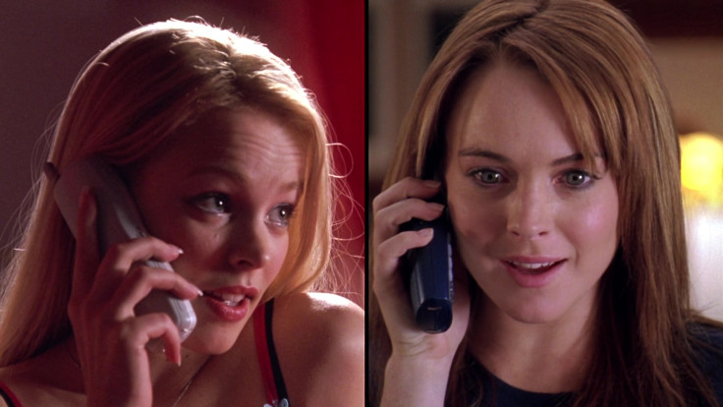
The Calendar Connection (1)
Do you want to hang out?
Sure!

Slide 5
The Calendar Connection (2)
When?
Do you want to hang out?
What time?
Where are we going?
Who is going with us?

Slide 6
The Calendar Connection (3)
LET ME CHECK MY CALENDAR!

Slide 7
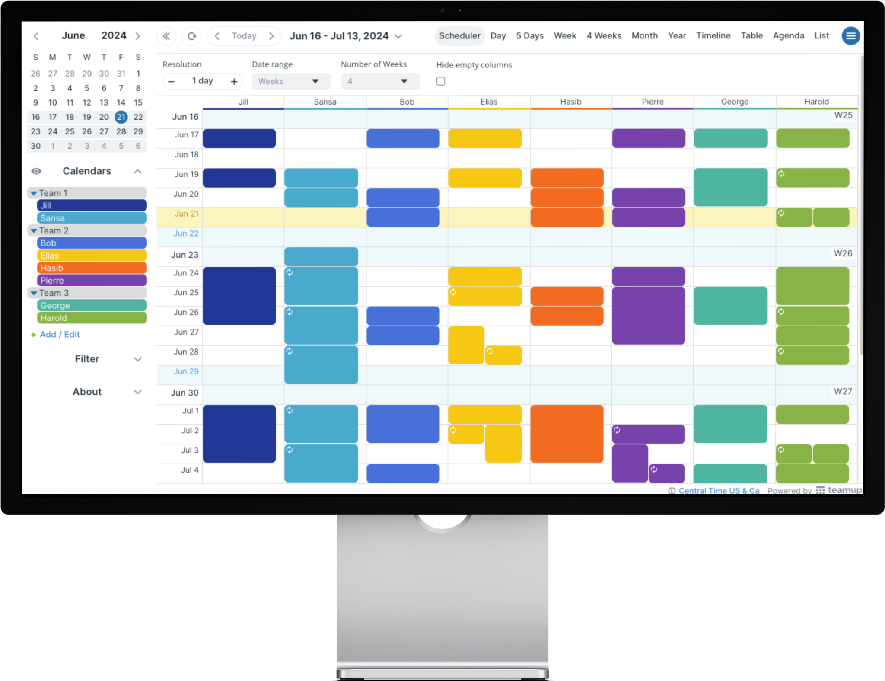
Why Calendars?
Communication
Concept development
Static versus dynamic representation
Concrete → Abstract representation
Time (past versus present versus future)
Social conversations
Shared experiences

Slide 8

Promote Emotional Well-Being
Security of knowing what will happen
Advance awareness of changes
Control in planning the day.
Revisit the past and understand past events.

Slide 9
Skills and Concepts in the Calendar System Continuum
Communication
Symbolic representation development
Builds dialogue
Shared topics of conversation
Choice-making
Time Concepts
Past, present, future
Sequencing events in an order
Teaches Time vocabulary
Introduces the concepts of a timepiece

Slide 10
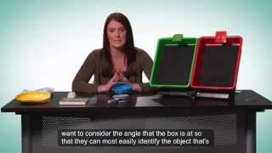
Anticipation Calendar Example
Notes:
https://youtu.be/Ry8sRlDkmpI?si=oy3QAlrdfA2t91kp

Slide 11
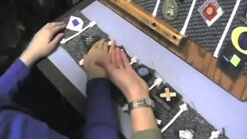
Example of Student Using Daily Calendar

Slide 12
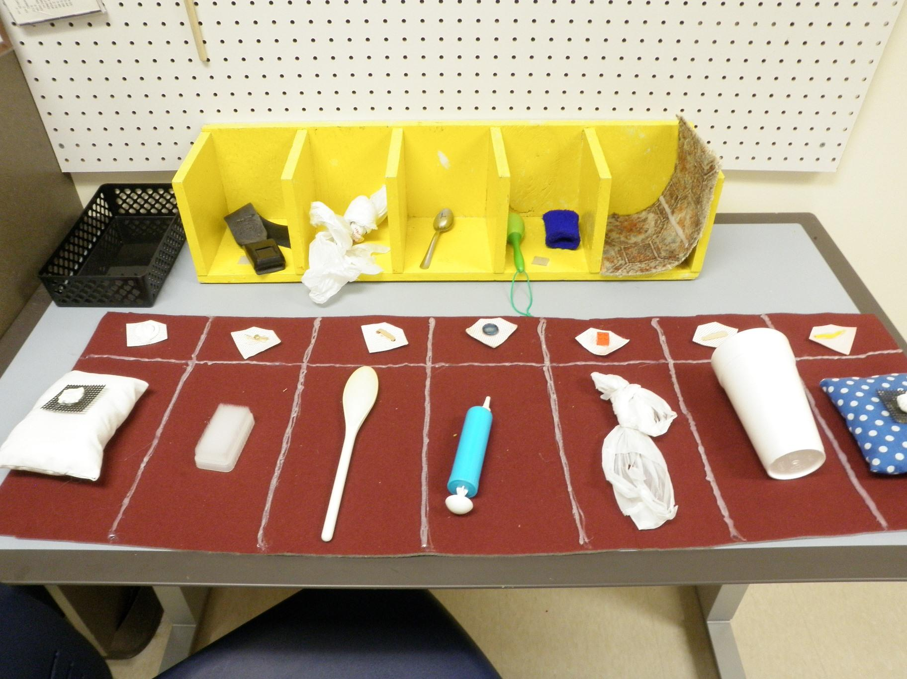
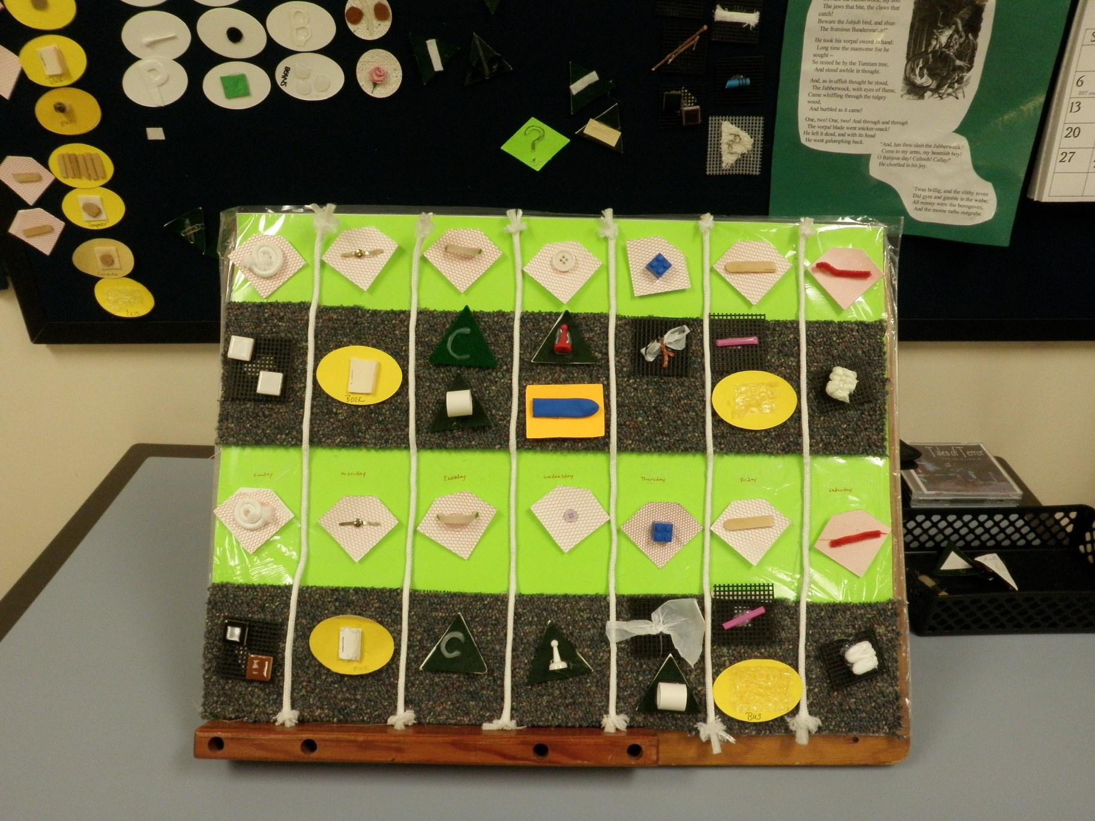
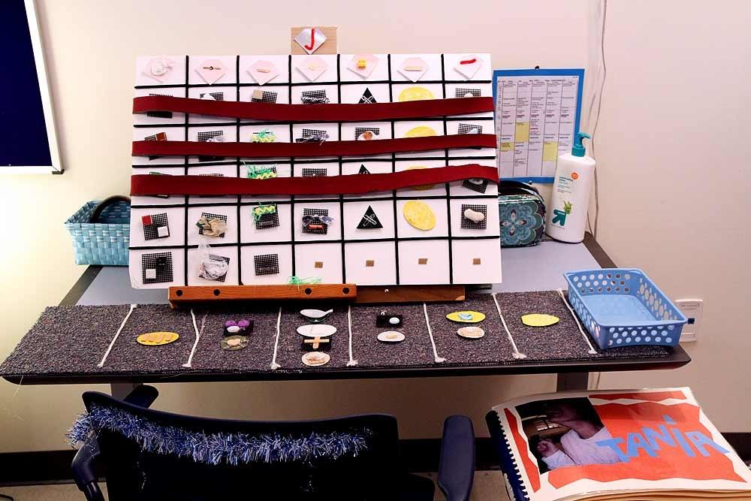
Expanded Calendars
Weekly
Multi-Week
Monthly
Notes:
From Blaha, R., Borg, J., Clyne, M., Hartman, V., Martin, B. (2015, September). Calendars. In National Center on Deaf-Blindness, Open Hands, Open Access: Deaf-Blind Intervener Learning Modules. Monmouth, OR: National Center on Deaf-Blindness, The Research Institute at Western Oregon University.

Slide 13
Selecting a Time Frame Checklist
Level 1
Anticipation Calendar
Level 2
Daily Calendar
Level 3
Expanded Calendar
Start with the Anticipation Calendar time frame, continue until the student misses a key characteristic (in bold).
Stop at this point. Select this time frame.
The student should be able to demonstrate the key characteristics of each time frame before moving to the next time frame.
The secondary characteristics (in italics) are not required but may help families and staff select a time frame.
p. 114
Notes:
Guide to Selecting Time Frames for Calendar Systems [TEMPLATE]

Slide 14

Which level Calendar System would you use?
Level 1
Anticipation Calendar
Level 2
Daily Calendar
Level 3
Expanded Calendar

Slide 15

Which level Calendar System would you use?
Level 1
Anticipation Calendar
Level 2
Daily Calendar
Level 3
Expanded Calendar

Slide 16
Time Frame Checklist
Level 1
Anticipation Calendar
Level 2
Daily Calendar
Level 3
Expanded Calendar
Looking across the time frames and characteristics:
What other questions or ideas do you have?
Notes:
Guide to Selecting Time Frames for Calendar Systems [TEMPLATE]

Slide 17
Selecting a Time Frame
Consider a student on your caseload
Go through the checklist to identify the time frame that you will use to design a calendar system.
Take notes! If you are unsure about specific items, design your team follow up questions or specific observation focuses for when you return to your school team.
Choose the time frame you will use to design a trial Calendar System*
Guide to Selecting Time Frames for Calendar Systems [TEMPLATE]
*Practice designing a systems will build your skills for when you return to your student(s). Consider this a first draft rather than a final product!

Slide 18

Selecting a Time Frame
Questions, comments or feedback?

Slide 19
Choosing Symbols
Things to Consider:
Is the student recognizing some people, locations, sounds associated with a few familiar activities within a routine?
Does the student act appropriately with one or two objects when engaged in familiar routines?
The student must have meaningful experiences with an object in content to recognize it out of context.

Slide 20
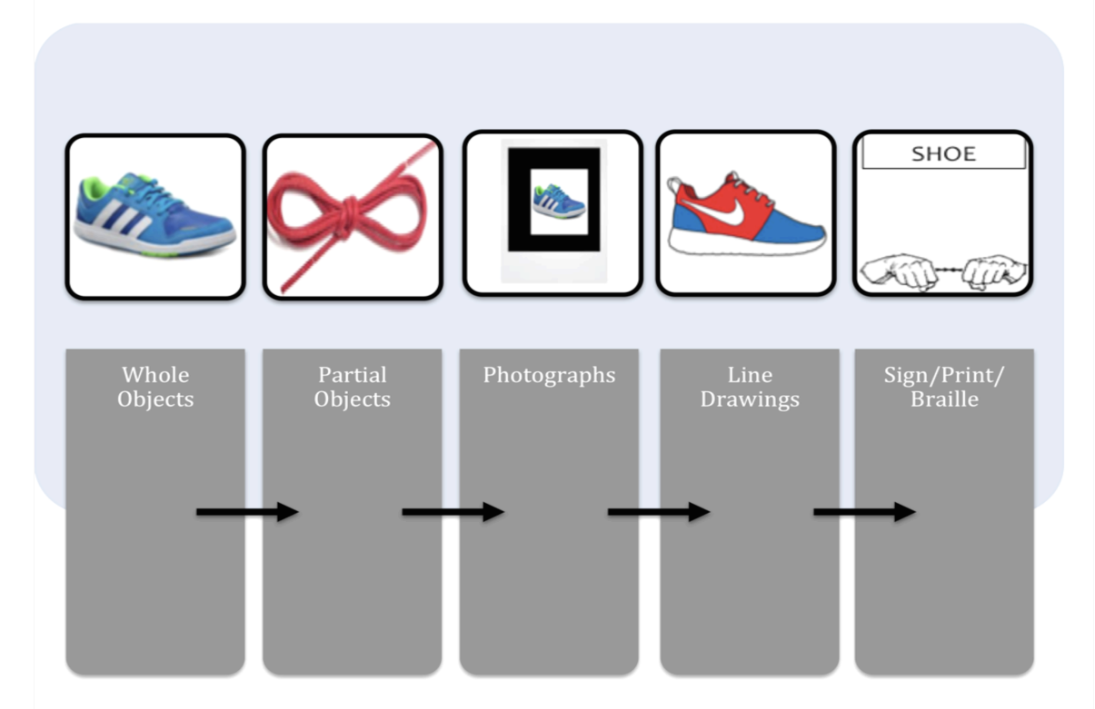
Symbolic Representation
Static
Whole Object
Partial Object
Photographs
Line Drawings
Sign/Print/Braille
Dynamic

Slide 21
Pause and Reflect
Look back at the battery you drew at the beginning of the session. Reflect on your knowledge now compared to where you started.
Connect - Extend- Challenge
Connect: What information can you connect with a student you are working with?
Extend: How did you extend your thinking and knowledge of calendar systems?
Challenge: What challenges come up for you as you think about developing and introducing a calendar system?

Slide 22
BREAK

Slide 23
Part 2: Calendar System Design
Learning Outcomes:
Participants will DESIGN a calendar system for students of their own.

Slide 24

Calendar System Deep Dive
Choose which type of calendar system you would like to dive into.
Anticipation Calendars: p 38-49
Daily Calendars: 59-77
Expanded Calendars: 91-109
Identify key features and considerations in calendar system design.

Slide 25
Choosing Calendar System Symbols
Consider Symbolic Representation (concrete > abstract)
Relevance to the child’s experience
Past, Present, and Future layout representation
Notes:
Resource: SUPPORTING COMMUNICATION DEVELOPMENT NCDB Practice Guide

Slide 26



Choosing and Using Symbols
Reflect and Revise Think Pair Share
Part 2: Choosing and Using Symbols
https://www.nationaldb.org/products/modules/pd/communication/M3L3/

Slide 27
Foundations before Beginning a Calendar System
Consider the following areas:
IEP Goals Addressed:
Example: Given a consistent daily calendar routine using an individualized calendar system (e.g., object, tactile, picture, or written symbols), the student will demonstrate anticipation of familiar activities or events (e.g., reaching, smiling, vocalizing, orienting, moving toward activity) following the presentation of calendar cues…
Accommodations and modifications
Student Communication System
Classroom Schedule and Activities
Connect to SOL Standards
Calendars, p 34

Slide 28
Connect to SoLs/VESOLs
VESOL:
R-3.3 (SOL 3.6D, 3.6E) The student will: Identify an event, idea, or step in a passage that is read to the student or that the student reads.
R-5.6 (SOL 5.6B, 5.6D) The student will: Identify details (an event, idea, or information) of a nonfiction text that is read to the student or that the student reads.
Math:
K.MG.3 The student will describe the units of time represented in a calendar.
1.MG.3 The student will demonstrate an understanding of the concept of passage of time (to the nearest hour and half-hour) and the calendar.
ELA:
K.FFR.1 Print Concepts: The student will apply knowledge of how print is organized and read.
Building vocabulary (Across grades): Use vocab across content areas
Retell events in sequential order (ex. 1.C.2)
2.RI.1 Key Ideas and Confirming Details A. Ask and answer literal and inferential questions (who, what, where, when, how, and why) about key details in a text. B. Retell key details of texts that demonstrate an understanding of the main topics of texts.

Slide 29
Calendar System Design
Based on the Time Frame Checklist: Choose Anticipation or Daily Calendar System
Choose 3-4 activities from YOUR Student’s Day OR if you are stuck, choose from activities from this list:
Circle Time
Lunch
PE/Gym
Choice time/Leisure or break time
Literacy
Music
Related Service (PT/OT/Speech/O&M)
Design a calendar system setup with past/present/future spaces

Slide 30
Designing the Calendar System Routine

Slide 31
Beginning a Calendar Routine
Tactile exploration of calendar space
Hand-under-hand
Anticipation Calendar:
Preparing object before hand in “FUTURE” basket
Use object to perform action to identify purpose
Perform activity with student.
Place in finished basked.
Daily Calendar:
Explore objects/symbols starting on LEFT
Keeping LEFT hand on LEFT edge and move RIGHT hand across the calendar to each division on time.

Slide 32
Calendar System Best Practices

Slide 33
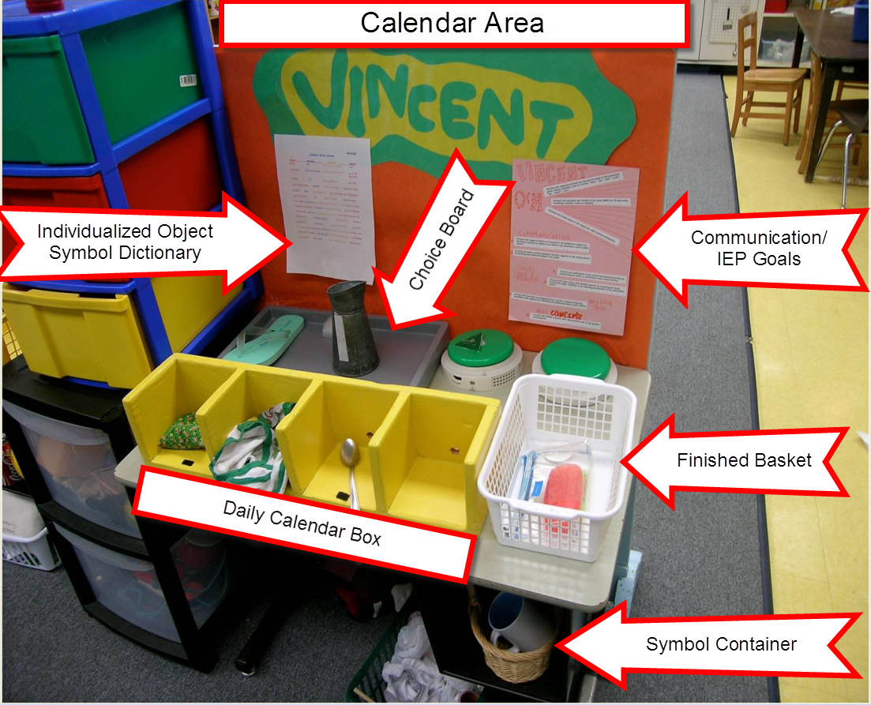
Calendar Routine Best Practices
Designated Calendar Area
Start of the Day, Every Day
Organization
Working through Change
Documentation
Family Collaboration

Slide 34

Working Through Change

Slide 35

Taking the Calendar System Back to Your Team
Why does your student need a calendar system?
✕ 5 why’s purpose planning
Select 3-5 key details or characteristics of a calendar system that your team needs to know to make it doable and impactful.
Consider 1 easy ask from the team.
= the perfect pitch

Slide 36
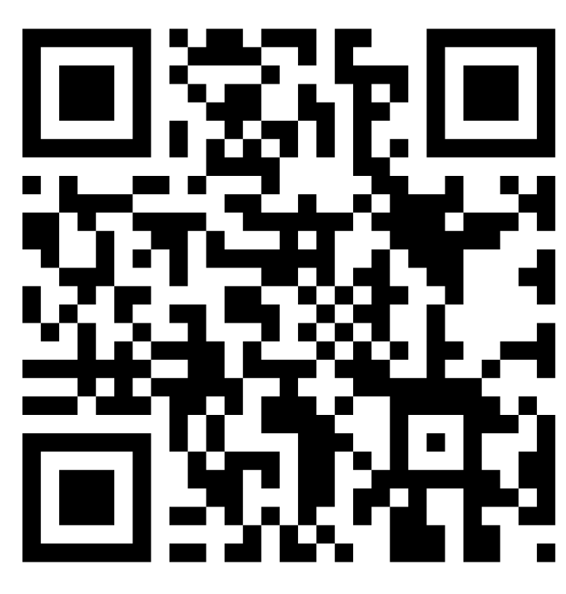
A Penny for your Thoughts (Evaluation)
Evaluation Link
https://tinyurl.com/VDBPCalendarSystems

Slide 37
Triangle-Circle-Square Reflection
Look back at the battery you drew at the beginning of the session. Reflect on your knowledge now compared to where you started.
Triangle: 3 points that you will remember.
Square: Something you learned that squares with your
beliefs.
Circle: A question still Circling in your head.

Slide 38




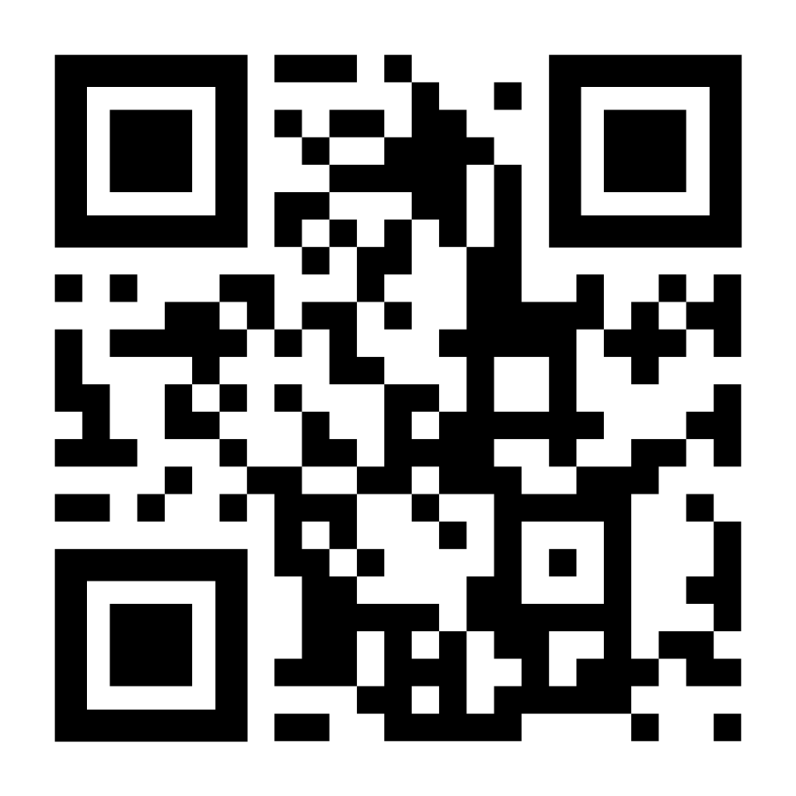
Let’s Connect
vadeafblind@vcu.edu
https://vadeafblindproject.partnership.vcu.edu/
https://www.facebook.com/VirginiaDeafblindProject/
http://instagram.com/vadeafblindproject
Join our Virginia Deafblind PLC:
https://forms.gle/u5wty8rE4daNR15V9

